Slide 1
Phase 1 project
Project Title: Microsoft Movie Studio Project
Student Name: Wyclife Omondi Orimba
Student Pace: Part-time
Date: 24th July 2023

Slide 2
PROJECT OVERVIEW
Microsoft has made a decision to enter into the movie industry by establishing a new movie studio.
However, they lack the necessary experience in the industry of entertainment to produce high-quality and original movies that appeal to a wider audience.

Slide 3
PROBLEM STATEMENT
Microsoft lacks experience in the entertainment industry, and this presents a major significant challenge in creating a successful movie studio. The company therefore, needs to identify the right talent, create a business plan, and establish relationships with distributors and other stakeholders to produce and distribute high-quality, original movies.
Additionally, they need to ensure that the movies appeal to a wide audience and generate revenue for the company. The lack of expertise in this area could result in the production of low-quality movies that fail to generate revenue, which could negatively impact the company's reputation and financial performance.
Therefore, the primary challenge is to overcome this lack of experience and create a successful movie studio that produces high-quality movies that appeal to a wide audience.

Slide 4
Objectives and Specification of project questions
To enter the entertainment industry through production of high-quality original movies.
To establish a sustainable and profitable business model for the movie studio which aligns with Microsoft's overall corporate strategy and objectives.
To establish a reputable and successful movie studio that contributes to Microsoft's overall growth and success.

Slide 5
An overview and analysis of the relationship between the production budget and the gross revenue
Analysis of the return on investment
Genre analysis
Runtime analysis
Correlation analysis of columns with float values

Slide 6
Data extraction and reading our data
import pandas as pd
import sqlite3
import csv
import numpy as np
import seaborn as sns
import matplotlib.pyplot as plt
%matplotlib inline
movie_df = pd.read_csv ('/content/bom.movie_gross.csv')
movie_df.head(5)

Slide 7
Budget_df = pd.read_csv ('/content/Dataset - 2021.csv')
Budget_df.head(5)
movie_type = pd.read_csv('/content/rt.movie_info.tsv', sep = "\t")
movie_type.head(10)

Slide 8
Data cleaning
The cleaning of this dataset will entail checking for duplicates and missing values.
Then depending on the number of values missing, we might group the entire column if the missing values are significant or drop either the rows with the missing values.
For the duplicated values in the Dataset, we will keep the first row and drop the rest of the duplicates. The data has no duplicates but has missing values so we will work on grouping the missing columns or rows.

Slide 9
STATISTICAL ANALYSIS-Studio and Domestic Gross Analysis
Checking which studios are producing high quality films.
Checking which studios are going to be a competition for microsoft studio.
Grouping the bom_movies dataset and group using studio and gross and plot a bar plot to show the average domestic gross for the top most ten studios.
movie_df_grouped = movie_df.groupby('studio')["domestic_gross"].mean()

Slide 10
Plotting a bar graph
plt.bar(topmost_studios["domestic_gross"].index, topmost_studios["domestic_gross"].values)
plt.xticks(rotation = 45 , fontsize = 10 , fontweight = "bold" , color = "red")
plt.xlabel("Studios" , fontsize = 10 , fontweight = "bold")
plt.ylabel("Average Domestic Gross", fontsize = 10 , fontweight = "bold")
plt.title("10 Top Studios by Domestic Gross", fontsize = 10 , fontweight = "bold")
plt.gcf().set_size_inches = "12 ,11"
plt.show()

Slide 11
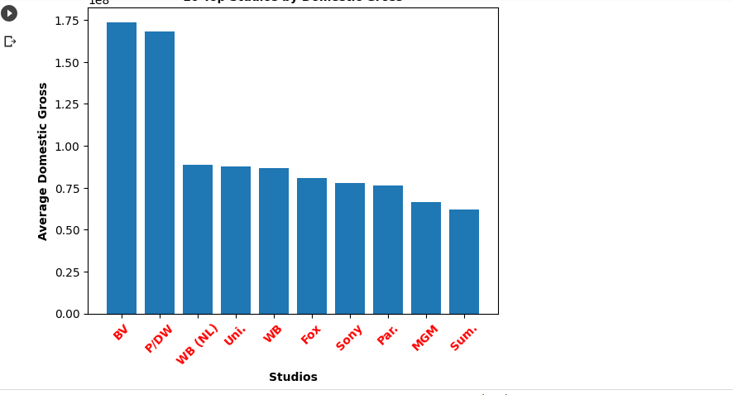

Slide 12
The bar graph above allows us to easily compare the average domestic gross for the top 10 studios. The top most studio is BV with a domestic gross averaging at 1.75m followed closely by P/DW averaging at 1.69m. Most of the studios are averaging between 7m and 8m indicating that they are not as dominant in the industry as the top 2 studio.
This therefore, will enable Miscrosoft be aware of the brands it will be competing with in the market. It will also be able to learn from the top most studios and find out what makeS BV and P/DW generate a high average domestic gross. Therefore, this information could be useful for Microsoft in determining which studios to target for potential partnerships or acquisitions.

Slide 13
Analysis of the return on investment(ROI)
plt.scatter(merged_data['production_budget'], merged_data['Return_on_investment'])
# Setting the title and labels
plt.title('Return on Investment vs Production Budget')
plt.xlabel('Production Budget')
plt.ylabel('Return on Investment')
# Show the plot
plt.show()

Slide 14
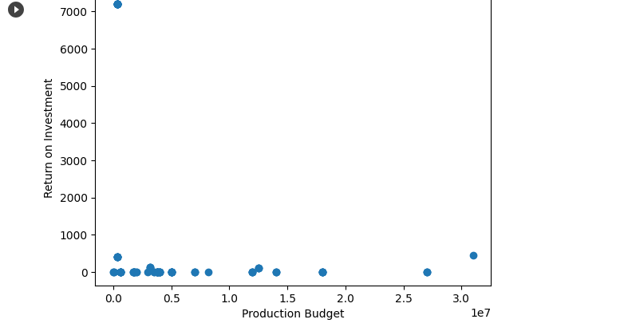

Slide 15
The scatter plot above shows the relationship between the production budget and return on investment for the 86 movies in the dataset. Each point on the plot represents a movie, with its corresponding production budget on the x-axis and the return on investment on the y-axis.
A higher return on investment(ROI) means that the movie is more profitable, while a lower return on investment means that the movie is less profitable. From the scatter plot, we can see that there is a wide range of return on investment values for movies with different production budgets.
We can also see a general trend implying that movies with higher production budgets tend to have higher return on investment values. This makes sense, as larger budgets generally allow for better production values(volumes), more marketing, and higher-quality talents involved in the production, which when all put together, contribute to a more successful movie.
However, there are also some outliers where movies with relatively low budgets were able to generate high returns on investment, indicating that success is not necessarily determined by the size of the budget.
Overally, the scatter plot provided a useful visualization of the relationship between production budget and return on investment in the dataset, highlighting some of the trends and outliers in the data.

Slide 16
Genre analysis
genre_counts = merged_data['genre'].value_counts()
# creating a bar graph to show the genre counts
plt.bar(genre_counts.index, genre_counts.values)
# setting the chart title and axis labels
plt.title('Genre Analysis')
plt.xlabel('Genre')
plt.ylabel('Number of Movies')
# rotating the x-axis labels to make them easier to read
plt.xticks(rotation= 90)
# displaying the chart
plt.show()

Slide 17
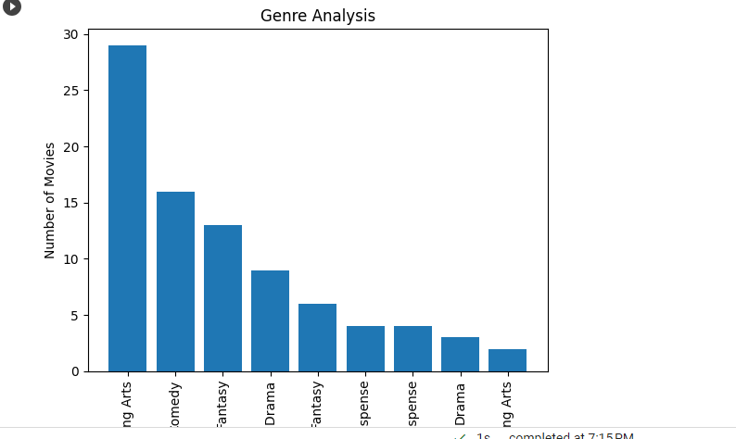

Slide 18
Based on the above bar graph plot, we can see that the that the most watched movie categorised by genre is Drama, followed by Comedy, Action, and Horror.
This is evidently highlighted by the height of the bars on the y-axis. Of importance to note also is that this analysis is based on the movies included in the dataset and may not be a true representation of the overall movie industry.
Furthermore, the popularity of genres may vary based on various factors such as cultural and societal influences, current events, and individual preferences.

Slide 19
Recommendations
Microsoft should consider producing Drama, Comedy, Action and Horror because they are the most watched movies.
Microsoft may consider more research and learn from BV and P/DW studios and discover what makes them the best studios with the highest averaging domestic gross.
Microsoft should also look at other ways to make a movie successful rather than having a big production budget. Since there is no correlation between the budget and the movies success.
Microsoft may consider engaging good script writers, directors , actors and quality videos for the success of the movies.

Slide 20
Thank you!

